Slide 1
FS104
PROJECT PRESENTATION
Kwang Wei

Slide 2
Content
Site Overview
Objective
User Stories
Wireframes
Code Guidelines
Visual Aids
Styles

Slide 3
Site Overview & Objectives
Site Type
Web App focuses on sports networking
Target Audience
Athlete, Coach, Sports Enthusiast.
Key Features
Creating Events
Build Sport Community
Objectives
Create a UI friendly platform that is easy to navigate & mobile responsive.
Web Visual: Professional & Sporty

Slide 4
User Stories
Persona | User Story | Goal
Athlete | Wants to present verified performance data | Increase discoverability by recruiters
Recruiter / Coach | Wants to search and evaluate athletes efficiently | Make informed recruitment decisions
Team Manager | Wants to manage team profiles and opportunities | Maintain accurate and visible team presence
Network User | Wants to connect and communicate with others | Build a professional sports network
Data-Oriented User | Wants to view performance metrics visually | Understand performance at a glance

Slide 5
Wireframe – Main page
Homepage
- Highlight about the web app’s feature like conveniently searching sports event near user and upcoming sports event.
LOGO | Brand Name
Home | About | Contact | Login | Register
Header Text
Paragraph Text
Header Text
Paragraph Text
Upcoming Event
Paragraph Text
Footer

Slide 6
Wireframe – User Page
User Page
Dashboard that allow user to track their personal activity.
All user to host/create their own events/ community.
LOGO | Brand Name
Home | About | Contact | Login | Register
Search
Dashboard
Create Event
Footer

Slide 7
Wireframe – About Page
About Page
- Allow user to understand more about the web app.
LOGO | Brand Name
Home | About | Contact | Login | Register
Header Text
Paragraph Text
Header Text
Paragraph Text
Footer

Slide 8
Wireframe – Contact Page
Contact Page
Allow user to send enquiries for partnership or make a report.
Simple contact form with name, email, subject & message
LOGO | Brand Name
Home | About | Contact | Login | Register
Header Text
Contact Form
Text
Text
Text
Footer

Slide 9
Tech Stack
React
Use semantic elements like header, nav, section & footer to structure content.
Ensure accessibility using proper alt attributes for images & labels for form inputs.
Use react component to render pages
CSS
Use external CSS for styling,
Leverage Bootstrap’s grid system for responsive design.
Backend
Use Node.js & Express.js to handle API, requests and send responses.
Database
Use MySQL libraries to handle all database operations

Slide 10
Visual Aids
Web App Layout
CSS Framework
Bootstrap for responsive layout
Custom CSS
For branding
JavaScript –react.js
For UI interaction with user
Webpage Graphic
Graphic Creation
Use tools like Photoshop & free stock images
Icon
Use bootstrap icons such as social media for engagement.
Fonts
Use readily available Google font and san-serif style for a modern and clean look.

Slide 11






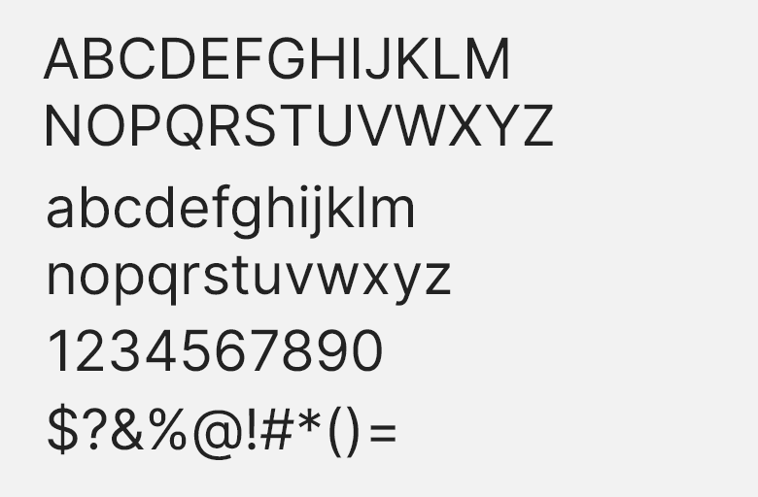
Styles – Color code & font
Color Palette
#0F172A
#22C55E
#F97316
#F8FAFC
#6B7280
Font Family
Monsterrat Font
Inter Font

Slide 12
End of Presentation

